Slide 1

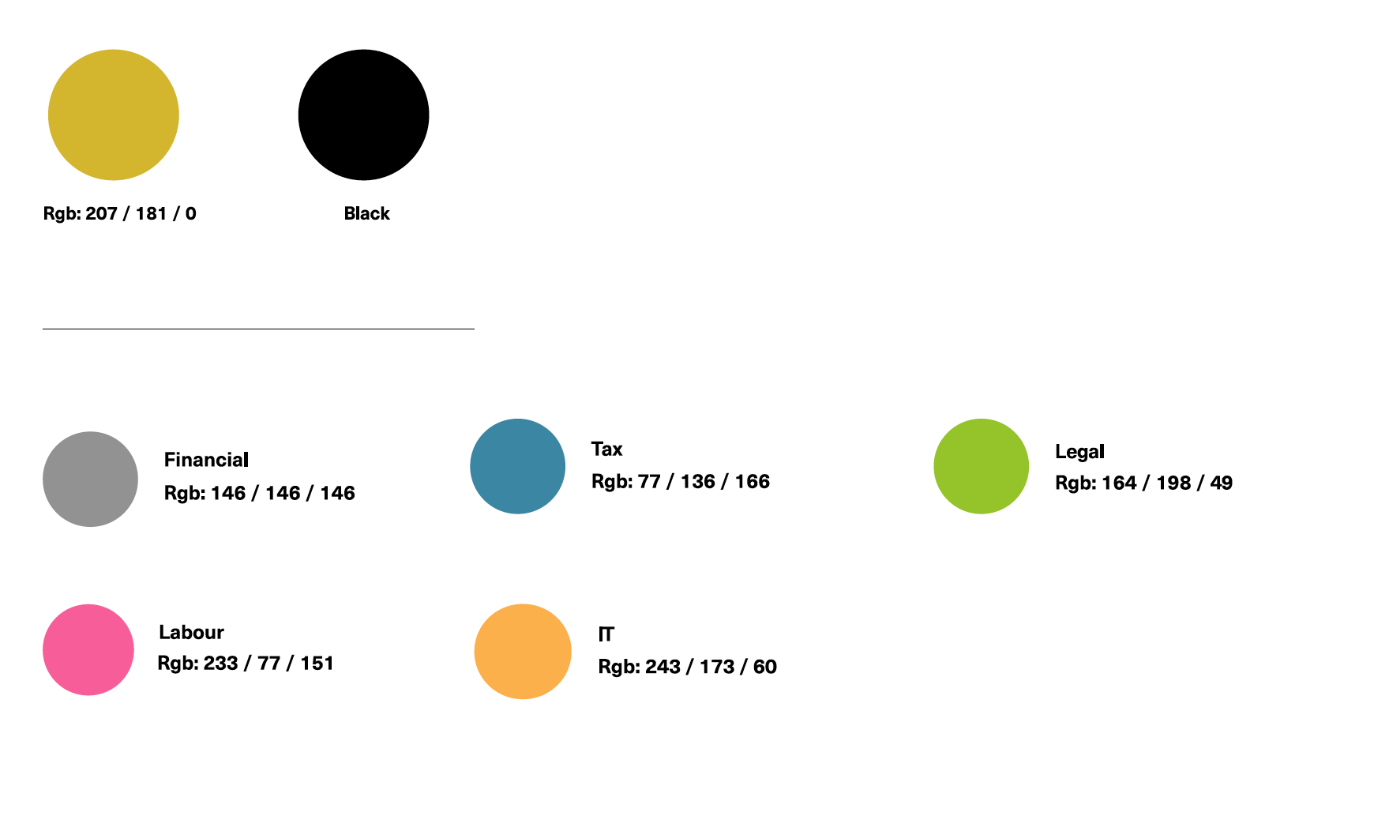
Brand Guidelines: Colour Palette

